Slide 1

Predictive Modeling for Loan Approval and Borrower Risk Assessment
Presented By:
Farah Naaz,
Adedamola Dosunmu,
Jahnavi Gogineni

Slide 2
Agenda
Project Overview
Proposed Solutions
Dataset Description
Descriptive Statistics
Data Preprocessing (Missing Values, Duplicates, Inflation Adjustment, Treatment of Outliers, Encoding, Scaling)
Visualization of Key Numeric and Categorical Features
Correlation Heatmap
EDA (Understanding Key Relationships)
Summary and Implications
Next Steps
Challenges

Slide 3
Project Overview
Business Problem Overview: At JAF Bank, borrower risk evaluation and loan approval decisions have traditionally relied on manual assessments and rule-based credit scoring systems.
Limitations of Rule-based Systems:
- Time-consuming
- Rigid and inflexible
- Ignores complex interactions
- Prone to bias
- Not predictive

Slide 4
Proposed Solutions
Use data processing techniques to ensure model-ready data (Outlier handling, inflation adjustment, encoding).
Leverage EDA to discover key relationships between variables.
Identify strongest predictors of loan approval.
Develop predictive models to determine the likelihood of loan approval.

Slide 5
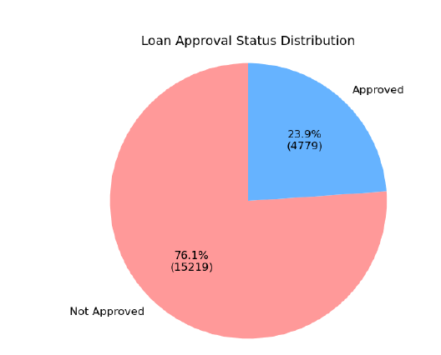
Dataset Description
- Data Set contained 20,000 rows and 36 columns.
- Features include demographics (age, education, marital status), Financial metrics (Income, debt, credit score)
- Target Variables: Loan approved, Risk Score.
- Inconsistent Values in “Application Date” which was removed from dataset.

Slide 6
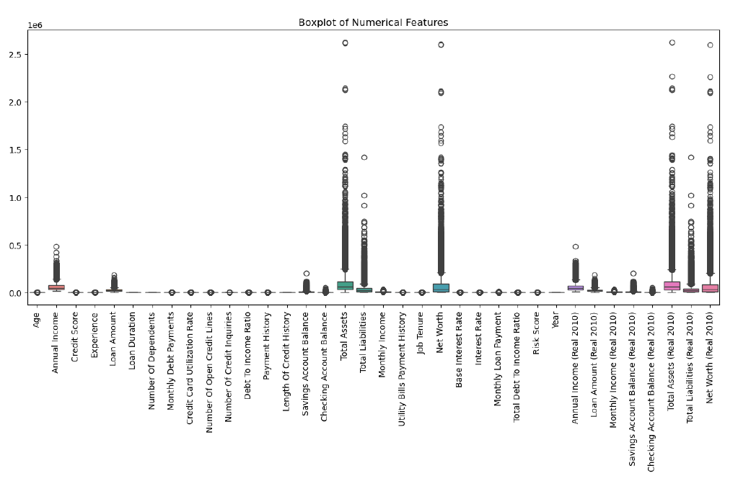
Data Preprocessing
Missing values – None in dataset
Duplicates - None in dataset
Adjustment for Inflation – considering 2010 as the base year
Detect Outliers – Used boxplots of numerical features to check for outliers

Slide 7
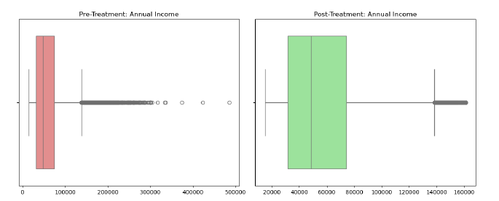
Treatment Of Outliers
Winsorization - Annual Income, Loan Amount, Savings Account Balance, Checking Account Balance.

Slide 8
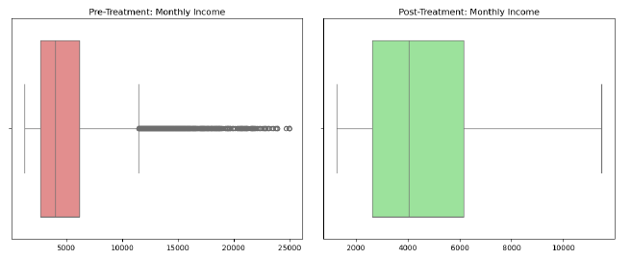
Treatment Of Outliers
IQR Capping - Monthly Debt Payments, Monthly Income, Monthly Loan Payment.

Slide 9
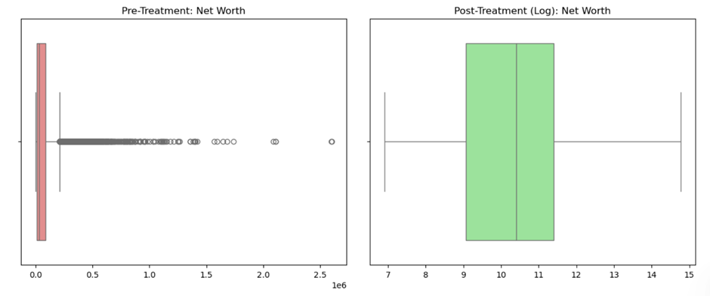
Treatment Of Outliers
Log Transformation - Total Assets, Total Liabilities, Net Worth

Slide 10
Data Preprocessing
1. Encoding:
Ordinal Encoding – Education Level
One-Hot Encoding - Employment Status, Marital Status, Home Ownership Status, Loan Purpose
2. Normalization/Standardization
Applied standardscaler to numeric variables

Slide 11
Descriptive Statistics Of Numerical Variables

Slide 12
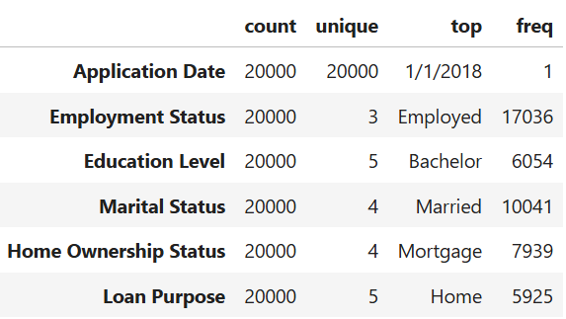
Statistical Description of Categorical Variables

Slide 13
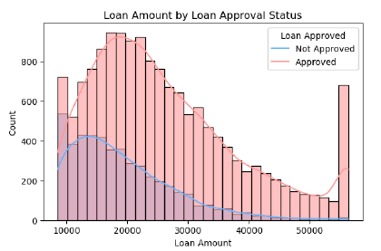
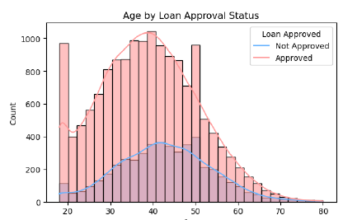
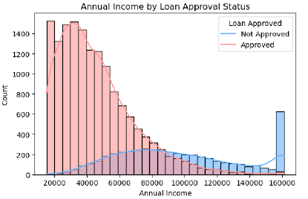
Distributions of Numeric Features
Notes:
In summary, these charts show a clear pattern — lenders seem to favor moderate, middle-range profiles: borrowers in their 30s and 40s, with steady but not extreme incomes, and reasonable loan requests.
Extreme values — whether it’s very young or old age, very high loan amounts, or unusually high income levels — tend to correlate with lower approval rates.”

Slide 14
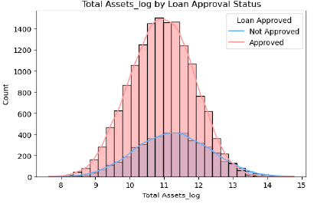
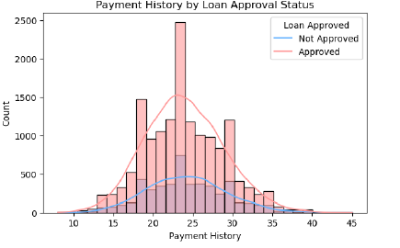
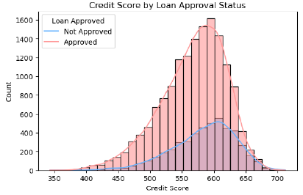
Distributions Of Numeric Features

Slide 15
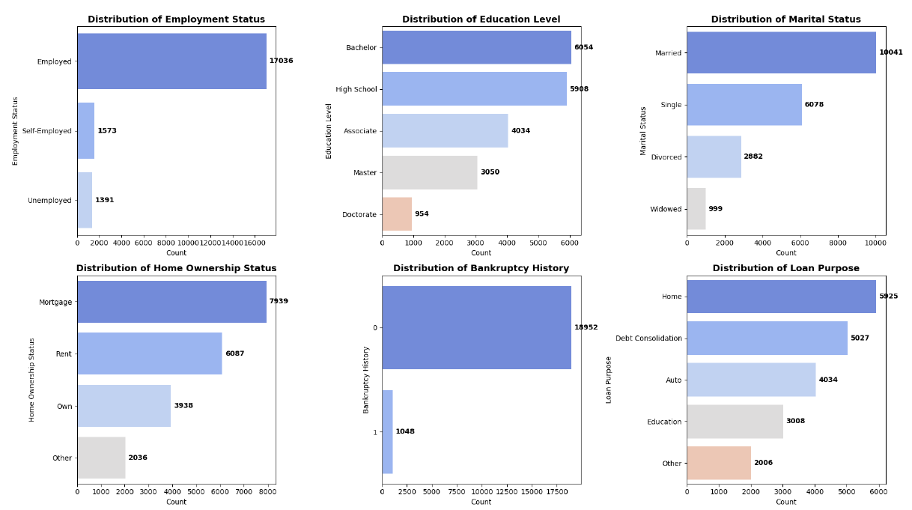
Distributions of Categorical Features

Slide 16
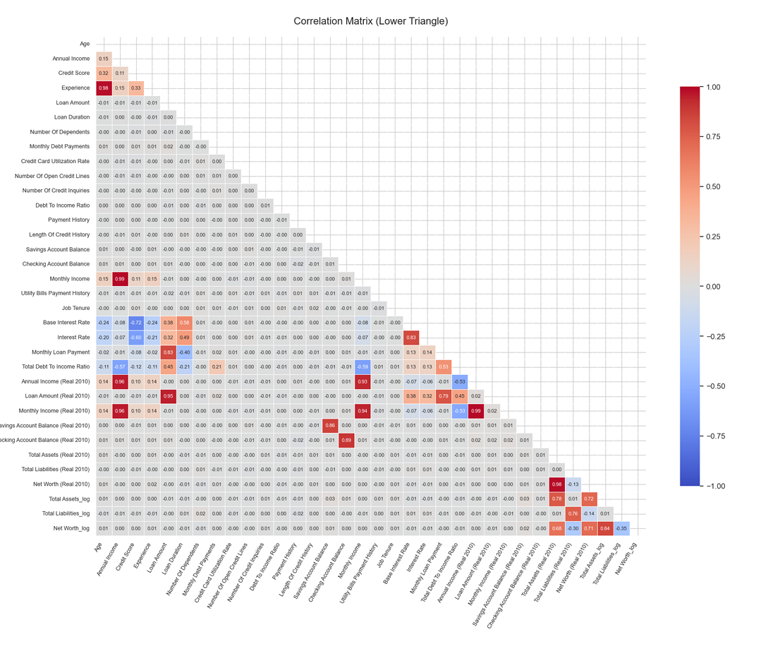

Slide 17
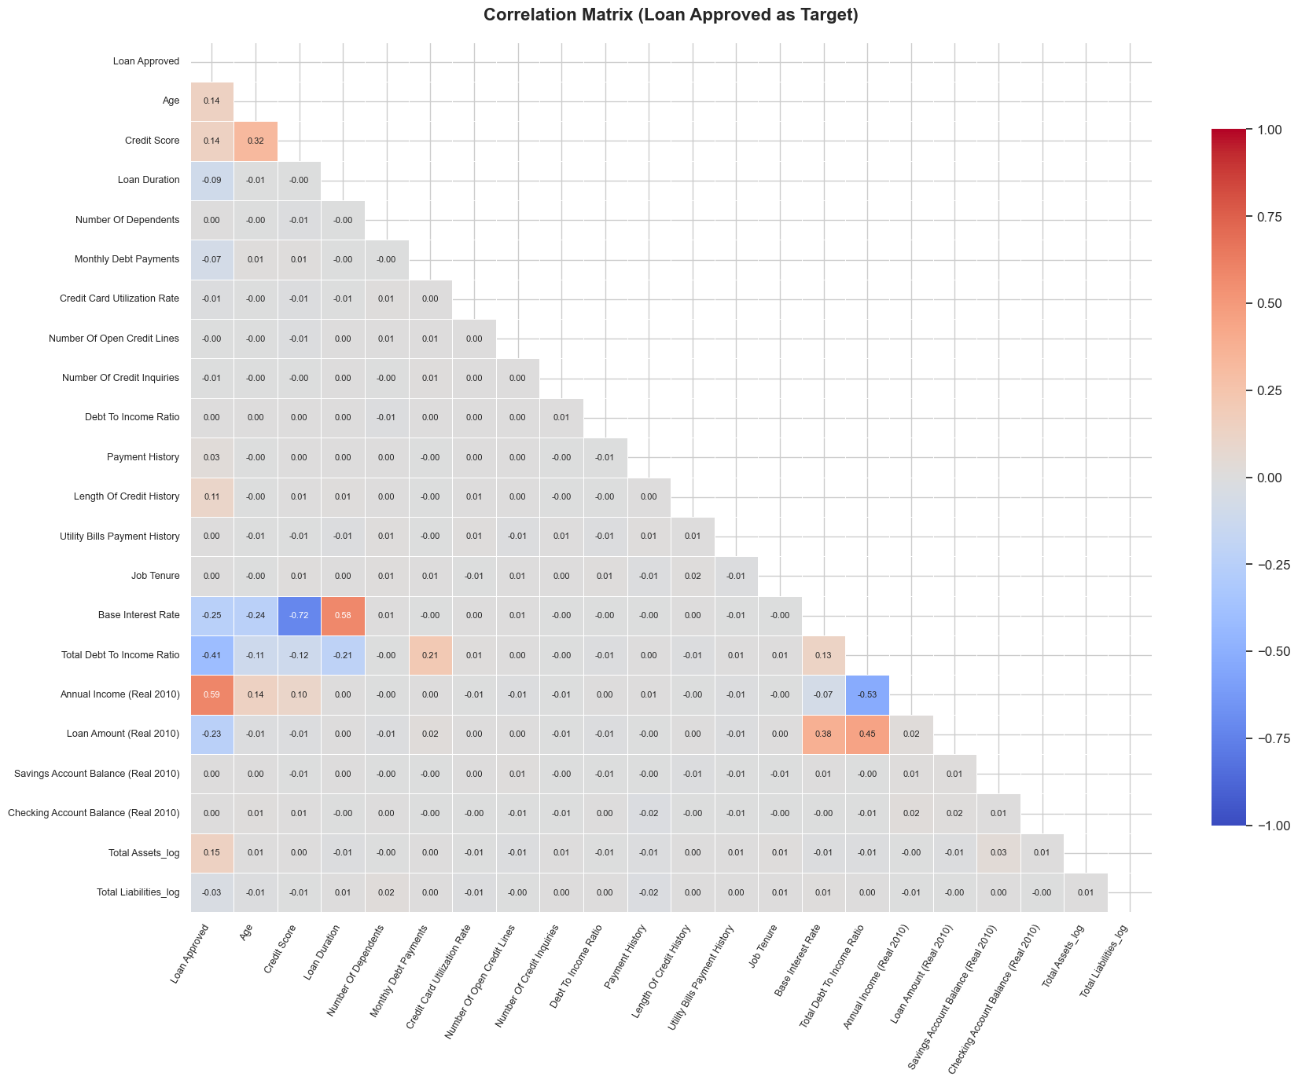
Correlation Matrix After Dropping Highly Correlated Cariables

Slide 18
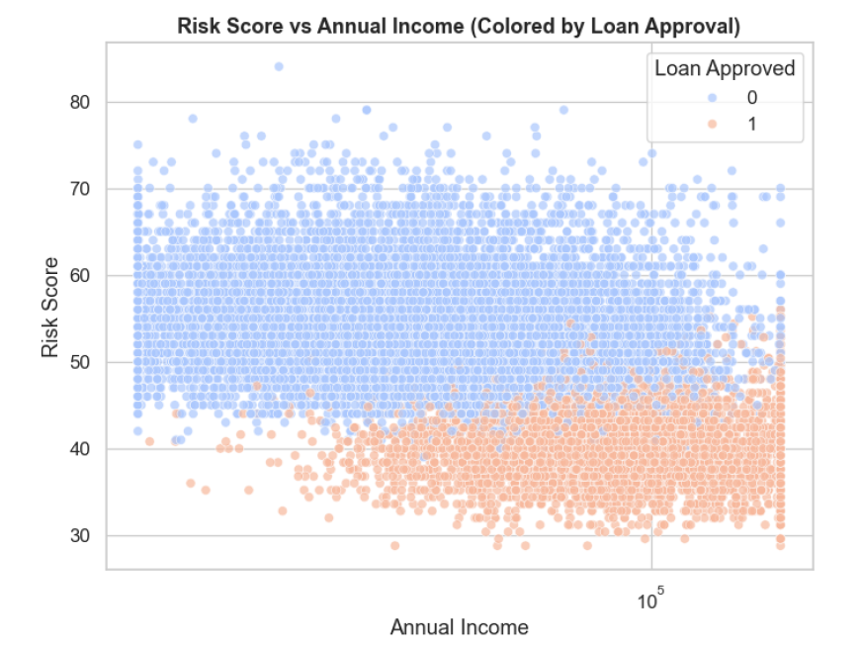
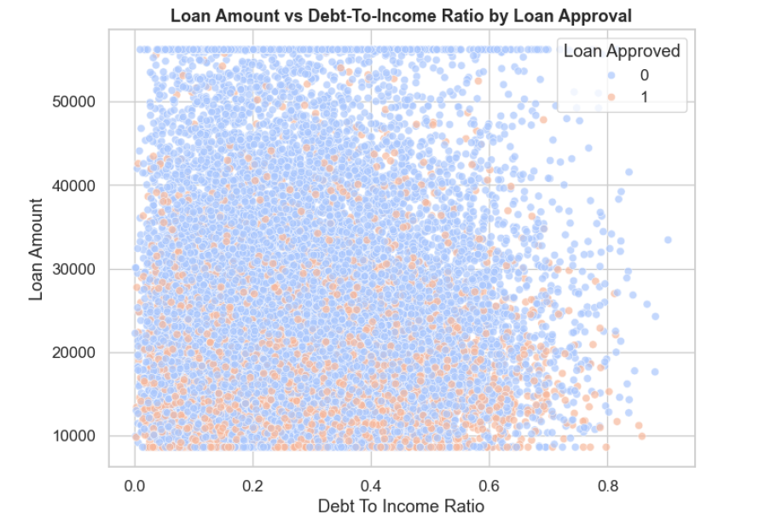
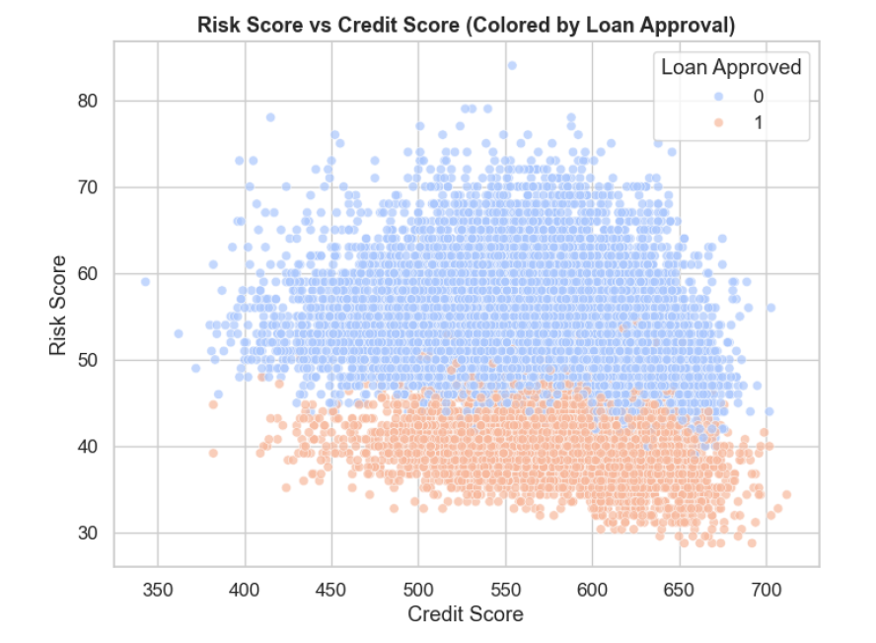
Key Relationships From EDA

Slide 19
Summary and Implications
Descriptive statistics and EDA revealed patterns: Loan Approval ≈ 76% Not Approved, 24% Approved.
Strong predictors: Income, Debt-to-Income Ratio, Credit Score.
Risk Score negatively correlated with Loan Approval.

Slide 20
Next Steps
Build and validate predictive models (classification & regression).
Evaluate performance using accuracy, precision, recall, RMSE.
Address potential overfitting.
Explore clustering or segmentation to identify borrower profiles

Slide 21

Anticipated Challenges
Synthetic data might pose a challenge in the performance of the model in real business scenarios.

Slide 22
References
Han, J., Pei, J., & Kamber, M. (2011). Data Mining: Concepts and Techniques. Elsevier.
Kuhn, M., & Johnson, K. (2013). Applied Predictive Modeling. Springer.
James, G., Witten, D., Hastie, T., & Tibshirani, R. (2021). An Introduction to Statistical Learning: with Applications in R and Python (2nd ed.). Springer.

Slide 23
Thank You
This presentation explored the loan approval project, emphasizing the significance of data preprocessing, exploratory analysis, and model building for effective credit risk evaluation. Questions are welcome.

